Slide 1
Firearm Mortality Rates in the U.S.
Patrick Weatherford – DSC 500
Introduction to Data Science

Slide 2
Overview
Goal:
Identify any correlations related to firearm mortality rates in the U.S, if any.
Hypothesis:
There is a positive correlation between firearm related mortalities and:
Gun Sales/Ownership
Gun Sale Background Checks
Mental Health Disorders
There is a negative correlation between firearm related mortalities and:
Gun restrictions/laws
Income Level
Patrick Weatherford – DSC 500 T301 2215-1 Spring 2021

Slide 3
Data Needed for Analysis
To perform the testing of the theory, I’ll be looking for data sets for the below topics.
Gun Sales/Ownership
Background Checks by State
Mental Health Disorders
Income Level
Gun Restrictions/Laws by State
Most of the research will be done using data from Google Trends. This however is not a restrictions and other data sets from reputable sources can be utilized to help prove or disprove the theory.
Patrick Weatherford – DSC 500 T301 2215-1 Spring 2021

Slide 4
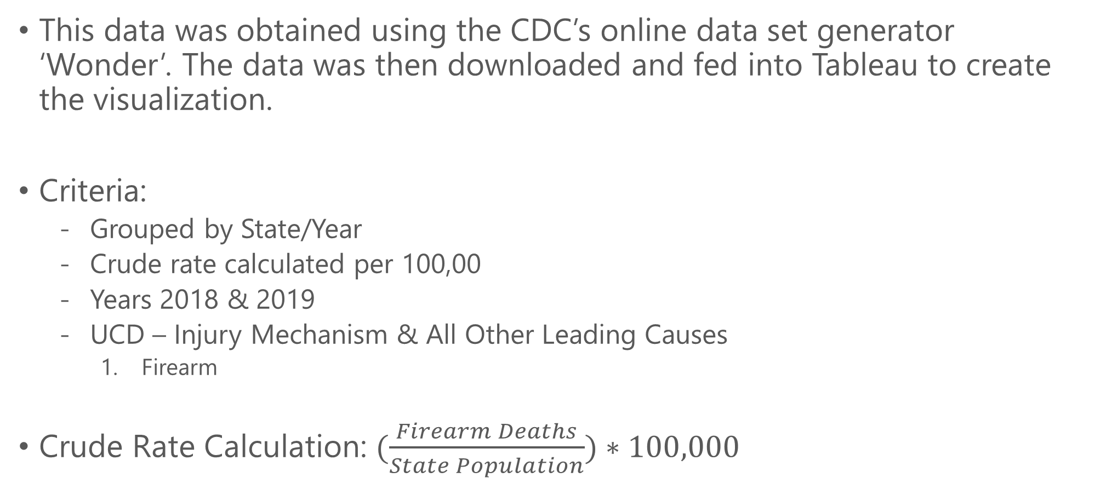
CDC Firearm Mortality Rate by State (2018 - 2019)
This data was obtained using the CDC’s online data set generator ‘Wonder’. The data was then downloaded and fed into Tableau to create the visualization.
Criteria:
Grouped by State/Year
Crude rate calculated per 100,00
Years 2018 & 2019
UCD – Injury Mechanism & All Other Leading Causes
Firearm
Crude Rate Calculation: $(\frac{Firearm Deaths}{State Population})∗100,000$
Patrick Weatherford – DSC 500 T301 2215-1 Spring 2021

Slide 5
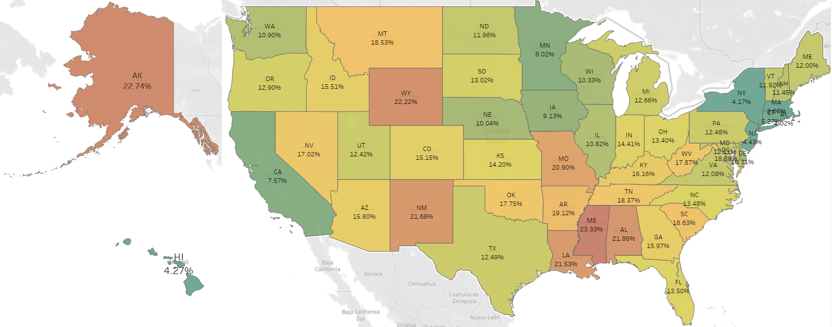
CDC Firearm Mortality Rate by State (2018 - 2019)
Data Retrieved from CDC, Wonder (2021).
Figure created by Patrick Weatherford.
Patrick Weatherford – DSC 500 T301 2215-1 Spring 2021

Slide 6
Google Trends Firearm Sales Search Popularity (2018 – 2019)
This data was obtained using Google Trends. The raw data was then downloaded and fed into Tableau.
Keywords being searched for:
Gun Store
Ammo
Buy Gun
Pistol
Shotgun
Date Range: 1/1/2018 – 12/31/2019
Patrick Weatherford – DSC 500 T301 2215-1 Spring 2021

Slide 7
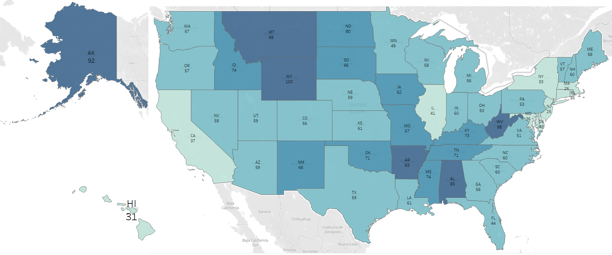
Google Trends Firearm Sales Search Popularity (2018 - 2019)
Data Retrieved from Google Trends (2021).
Figure created by Patrick Weatherford.
Patrick Weatherford – DSC 500 T301 2215-1 Spring 2021

Slide 8
Median Income by State (2018 – 2019)
This data was obtained from the Census.gov website which houses public information regarding median income by state/year. The data was then created into a .txt file and fed to Tableau to create the visualization.
Date Range: 1/1/2018 – 12/31/2019
Patrick Weatherford – DSC 500 T301 2215-1 Spring 2021

Slide 9
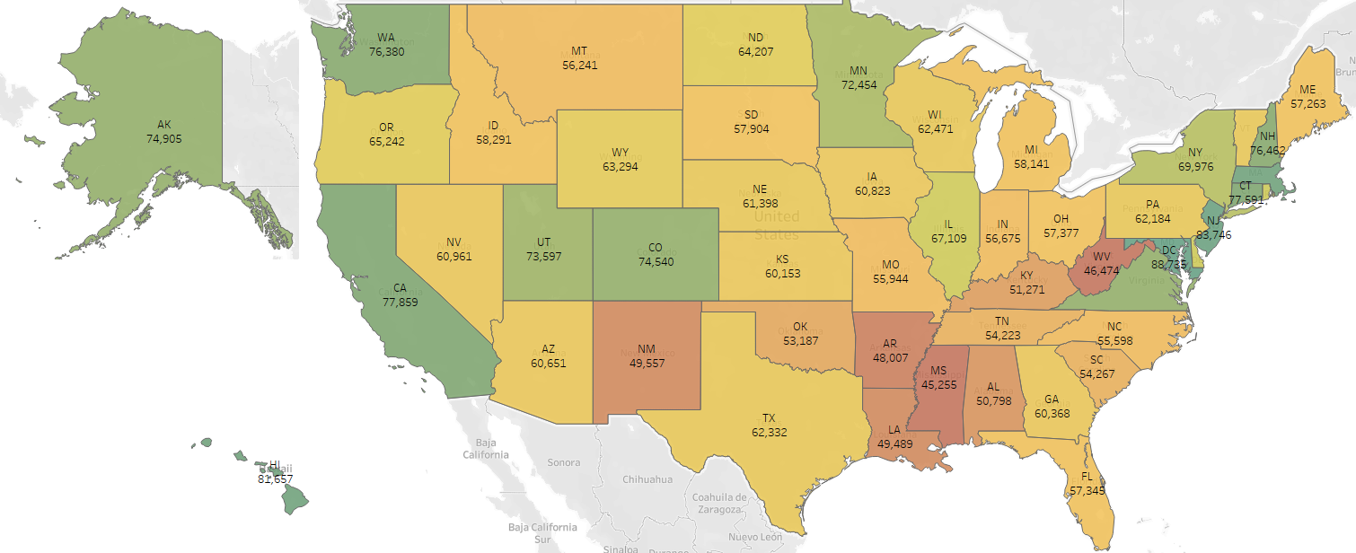
Median Income by State (2018 – 2019)
Patrick Weatherford – DSC 500 T301 2215-1 Spring 2021

Slide 10
FBI NICS Firearm Checks (2018 – 2019)
This data was obtained from the FBI.gov website which houses public information regarding firearm background checks by state/year. The data was then created into a .txt file and fed to Tableau to create the visualization.
Date Range: 1/1/2018 – 12/31/2019
Patrick Weatherford – DSC 500 T301 2215-1 Spring 2021

Slide 11
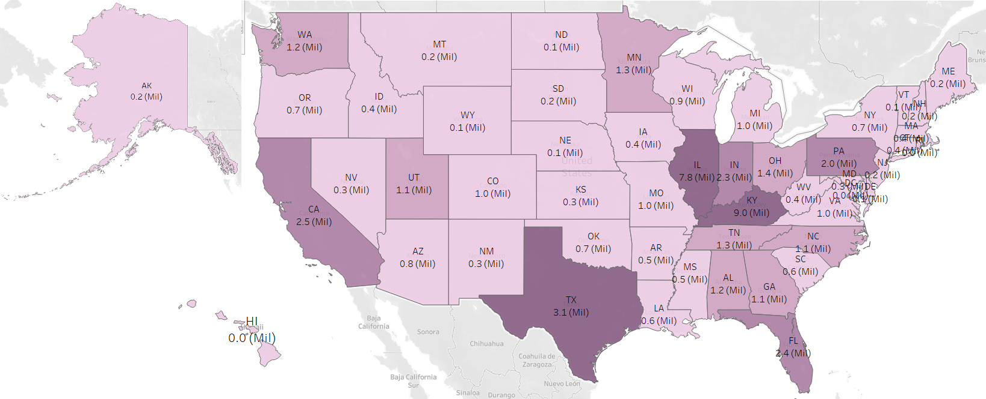
FBI NICS Firearm Checks (2018 - 2019)
Data Retrieved from FBI.gov (2021).
Figure created by Patrick Weatherford.
Patrick Weatherford – DSC 500 T301 2215-1 Spring 2021

Slide 12
Mental Health Related Searches (2018 – 2019)
This data was obtained using Google Trends. The raw data was then downloaded and fed into Tableau.
Keywords being searched for:
Mental Health
Depression
Anxiety
Suicide
Date Range: 1/1/2018 – 12/31/2019
Patrick Weatherford – DSC 500 T301 2215-1 Spring 2021

Slide 13
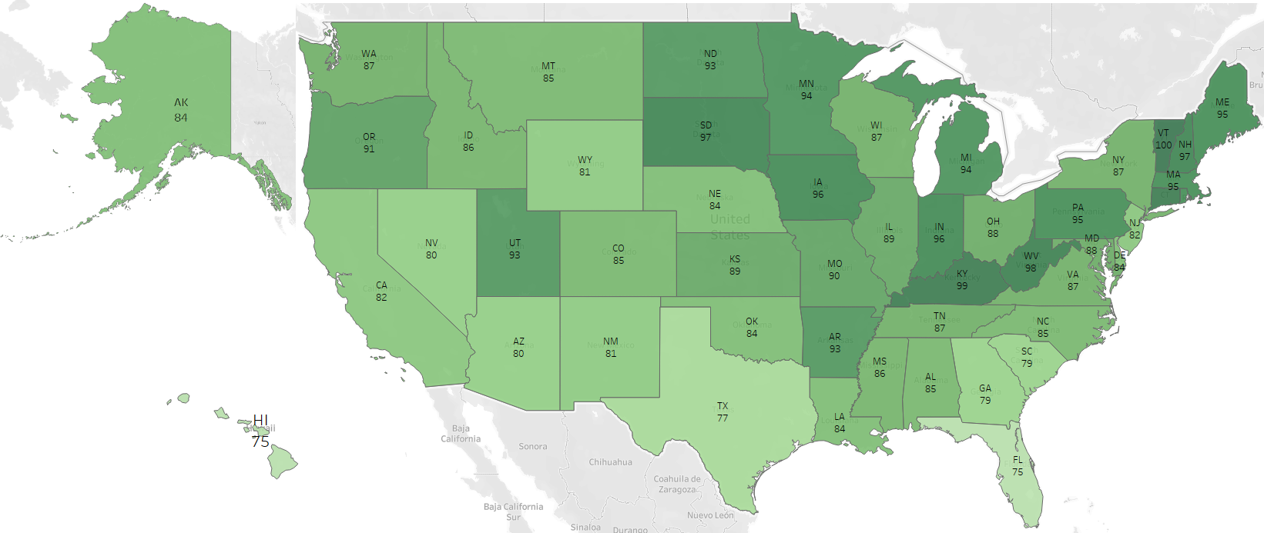
Mental Health Related Searches (2018 - 2019)
Data Retrieved from Google Trends (2021).
Figure created by Patrick Weatherford.
Patrick Weatherford – DSC 500 T301 2215-1 Spring 2021

Slide 14
Gun Friendly States Ranked
This data was obtained from 2 different sources to get the ranking.
Giffords Law Center Gun Law Scorecard
AZ-Defenders
My main goal was to find multiple sources where gun law restrictions were ranked since gun law rank has a potential to be somewhat bias. I found a source that seemed to be pro-gun restrictions (Giffords rank) and one source that seemed to be pro-2nd amendment (AZ-Defenders). I then got the difference between the 2 ranks to get the “realized” rank.
Giffords gave a higher score to states with more gun restrictions
AZ-defenders gave a higher score to states that were more gun friendly
*Giffords ranked states by a letter grade (A-, C, B+, etc.) while AZ-Defenders had a numerical GFI (gun friendly index). I first converted the letter grade to a numerical value before finding the difference between Giffords rank and AZ-Defenders rank.
Patrick Weatherford – DSC 500 T301 2215-1 Spring 2021

Slide 15
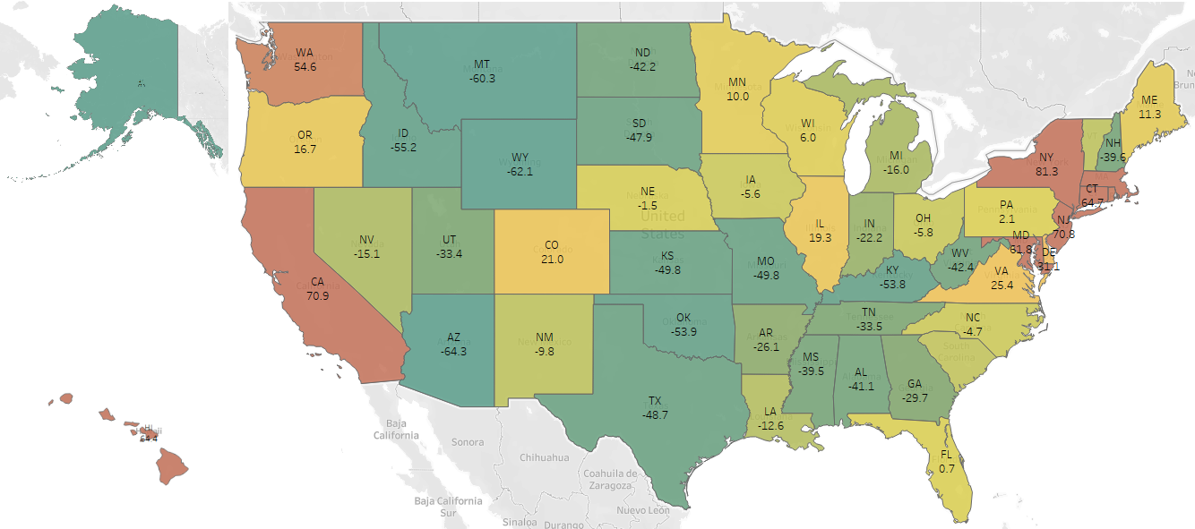
Gun Friendly States Ranked
Patrick Weatherford – DSC 500 T301 2215-1 Spring 2021

Slide 16
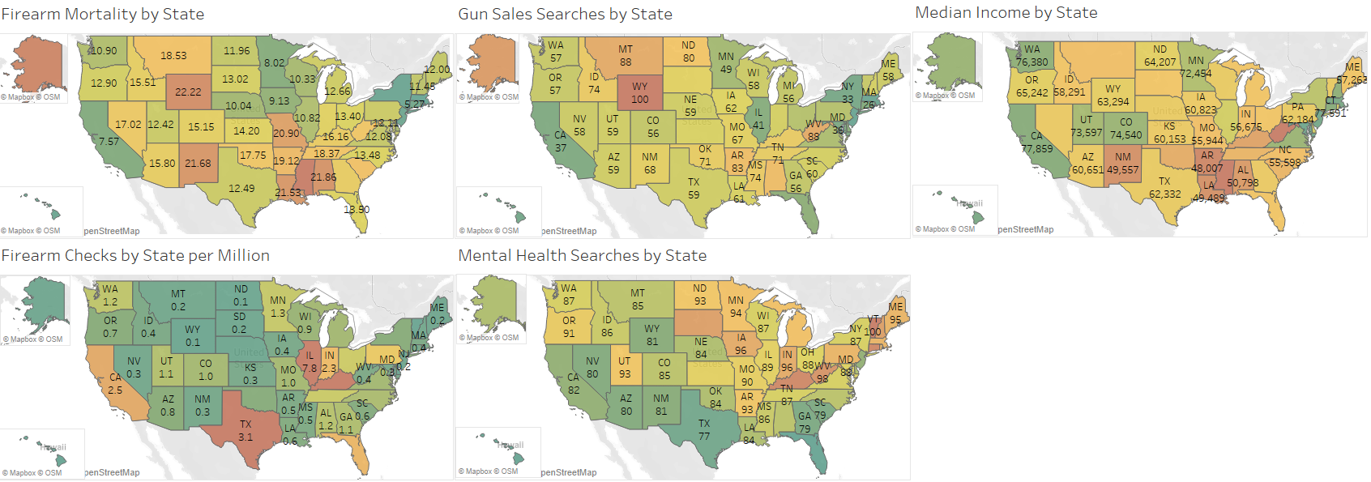
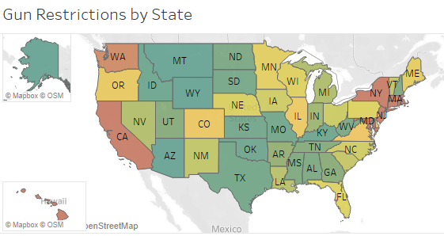
Data Comparison Overview
Data Retrieved from Google Trends, FBI.gov, Census.gov, CDC.gov
Figure created by Patrick Weatherford.
Patrick Weatherford – DSC 500 T301 2215-1 Spring 2021

Slide 17
Finding Correlations
In the next slides I plotted the data in a graph showing the gun death rate as the x-axis and the other various metrics as the y-axis.
I then plotted a linear regression line to see if there was any strong positive or negative correlation with any of the other metrics.
Patrick Weatherford – DSC 500 T301 2215-1 Spring 2021

Slide 18
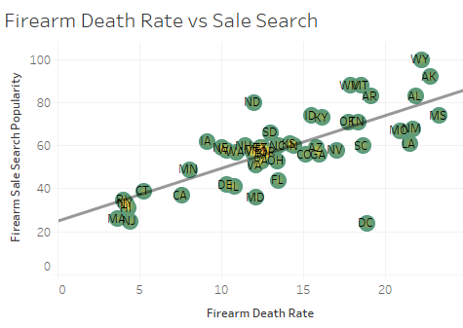

Firearm Death Rate vs Gun Sale Search Popularity
Strong positive Correlation
Conclusion is that gun sale search popularity is significant. As sale search popularity increases, so does the firearm death rate.
Patrick Weatherford – DSC 500 T301 2215-1 Spring 2021

Slide 19
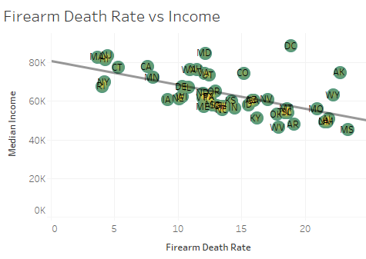

Firearm Death Rate vs Median Income
Fairly strong negative correlation
Conclusion is that median income level is somewhat significant. As median income increases, firearm death rates decrease.
Patrick Weatherford – DSC 500 T301 2215-1 Spring 2021

Slide 20
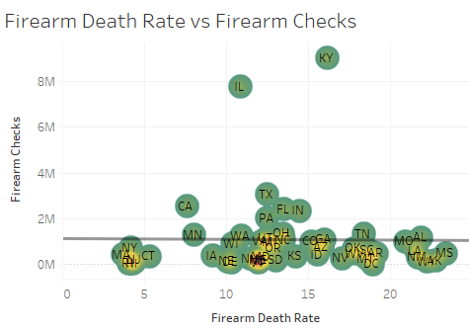

Firearm Death Rate vs Firearm Background Checks
No correlation, P-value is high.
Conclusion is that firearm background check volume is not a significant factor.
Patrick Weatherford – DSC 500 T301 2215-1 Spring 2021

Slide 21
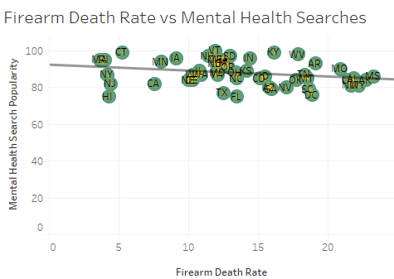

Firearm Death Rate vs Mental Health Search Popularity
Extremely slight negative correlation. P-value high.
Conclusion is that mental health search popularity is not significant. It is interesting however that the correlation, even though insignificant, is negative. This meaning that as mental health search popularity decreases that firearm mortality rates increase.
Patrick Weatherford – DSC 500 T301 2215-1 Spring 2021

Slide 22
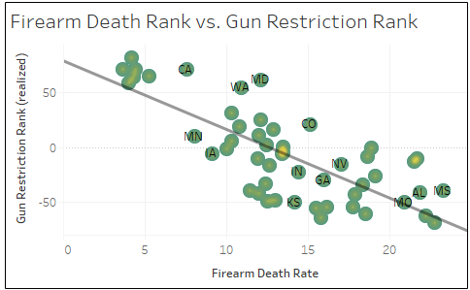

Firearm Death Rate vs Gun Restriction Rank
Strong negative correlation
Conclusion is that gun restriction rank is significant. As gun restrictions increase, firearm death rates decrease.
Patrick Weatherford – DSC 500 T301 2215-1 Spring 2021

Slide 23
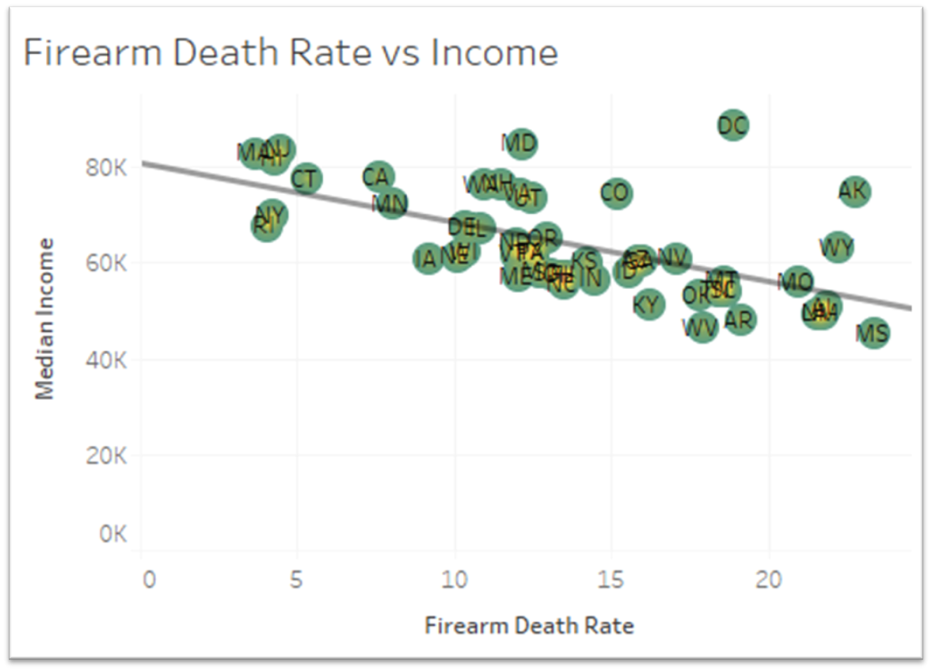
Correlations (all)
Patrick Weatherford – DSC 500 T301 2215-1 Spring 2021

Slide 24
Conclusion
There is a strong correlation between firearm mortality rates and:
Gun sale search popularity – R-squared=0.545
As gun sale search popularity increases, so does the firearm mortality rate.
Gun restrictions (strongest correlation) – R-squared=0.587
As gun restrictions increase, firearm mortality rates decrease.
There is a fairly strong correlation between firearm mortality rates and:
Median income level – R-squared=0.358
As the median income level increases, firearm mortality rates decrease.
There is no significant correlation between firearm mortality rates and:
Mental health search popularity
Firearm background check volume
Patrick Weatherford – DSC 500 T301 2215-1 Spring 2021

Slide 25
References
CDC, Wonder - Multiple Cause of Death, 2018-2019. (2021). Retrieved from https://wonder.cdc.gov/mcd-icd10-expanded.html
Google Trends – Gun Sale Searches, 2018-2019. (2021). Retrieved from gun store + ammo + buy gun + pistol + shotgun - Explore - Google Trends
Google Trends – Mental Health Searches, 2018-2019. (2021). Retrieved from mental health + depression + anxiety + suicide - Explore - Google Trends
NICS Firearm Checks: Month/Year by State — FBI. (2021). Retrieved from https://www.fbi.gov/file-repository/nics_firearm_checks_-_month_year_by_state.pdf/view
2019 Median Household Income in the United States. (2021). Retrieved from https://www.census.gov/library/visualizations/interactive/2019-median-household-income.html
2018 Median Household Income in the United States. (2021). Retrieved from https://www.census.gov/library/visualizations/interactive/2018-median-household-income.html
An Analysis of Gun Laws by State. (2021). Retrieved from https://www.az-defenders.com/best-states-for-gun-owners/
Gun Law Scorecard. (2021). Retrieved from https://giffords.org/lawcenter/resources/scorecard/#rankings
Patrick Weatherford – DSC 500 T301 2215-1 Spring 2021

Slide 26
Tableau File
Attached is the Tableau file created for the visualizations.

